Slide 1
Signaling Solution for HP-WAN
Quan Xiong(ZTE)
IETF 123 @ Marid HP-WAN Side meeting
July, 2025

Slide 2
Host-network Collaboration Signaling
The host-network collaboration signaling is enabled to enhance the congestion control in HP-WAN.
The client and server could send the traffic efficiently with the negotiated rate- based congestion control in a fine-grained way.
The network could provide rate-based quota reservation and admission control to achieve predictable network behaviour.
The edge node could enhance the capability to provide traffic scheduling and enforcement to mitigate incast network congestion and minimize flow completion times.
Client
HP-WAN
Server
Transport
CC algrithm
Rate negotiation
Transport
Traffic scheduling and enforcement
Ingress
Edge
Transit Node
Egress
Edge
Transport
CC algrithm
CC algrithm
Rate-based quato reservation and admission control
Transport
CC algrithm
Host-network Collaboration Signalling
1
Notes:
Quota is expressed as a vector of
resource quantities (bandwidth, buffer, queue, etc.) at a given
priority, for a time frame. The network can make dynamic bandwidth
reservation upon different time frames defined by quota.

Slide 3
Rate Negotiation Policy for Host-network Collaboration
There are three kinds of rate policy with the following negotiation processing:
The host sends job-based requests to the network to negotiate the sending rate before data transmission
The network schedules the requests and performs the admission control based on available capacity. The network performs dynamic resources reservation upon different time frames defined by quota. The nodes along the path need to subtract the resource quota within the time frames, but not reserve it while the traffic in the network are still sharing the resources. The subtraction result will be viewed as the resources constraints for the admission control. The requests will be accepted when the rate-based resource quota reservation is succeed, otherwise, it will be rejected.
After the acknowledgement of admisson, the client could transmit the job-based flows at negotiated rate based on the rate policy.
Minimum Rate Negotiation
Maximum Rate Negotiation
Constant Rate or Range Negotiation
The host will request the network to provide the minimum resource guarantee in minimum rate negotiation policy.
Min-rate = Flowsize/(CompletionTime-StartTime)
The client could transmit the job-based flows at a sending rate not less than the minimum rate.
The host will request the network to provide an upper limit for resource guarantee in maximum rate negotiation policy.
Max-rate = a*Bandwidth/FlowNumber
The client could transmit the job-based flows at a sending rate not greater than the maximum rate.
The host will request the network to provide dynamic resource reservation to guarantee optimal rate or rate range transmission in constant rate negotiation policy.
The network performs high-level resources planning and allocate optimal rates for the time frames with multiple intervals.

Slide 4
Stitching signaling
The host-network collaboration signaling can be implemented as stitching signaling between host-network and in-network.
The P2P signaling (e.g GRASP and RSVP) can be provisioned between the client and the network edge node.
The quato reservation signaling (e.g RSVP) can be provisioned along the network nodes.
Client
Edge Node
Transit Nodes
Edge Node
Server
Request (traffic pattern)
Rate negotiation
Traffic scheduling and enforcement
Acknowledgement
(negotiated rate)
Admission control
Reserve resource quota
Traffic (negotiated rate)
Traffic (negotiated rate)
Traffic (negotiated rate)
Traffic (negotiated rate)
New Request
Update(negotiated rate)
Notification(completion)
Release resource quota
Acknowledgement(cancle)
P2P signaling between client and edge node
Quato reservation signaling along network nodes
2

Slide 5
Hop-by-hop signaling
The host-network collaboration signaling can be implemented as hop-by-hop signaling (e.g.RSVP).
It can be end-to-end provisioned along the path from client, network nodes and server.
Client
Edge Node
Transit Nodes
Edge Node
Server
Rate negotiation
Admission control
Reserve resource quota
Traffic (negotiated rate)
Traffic (negotiated rate)
Traffic (negotiated rate)
Traffic (negotiated rate)
Release resource quota
Hop-by-hop signaling along the client, network nodes and server
3

Slide 6
Overlay signaling
The host-network collaboration signaling can be implemented as overlay signaling to alleviate the operational and scalability issues.
It can be end-to-end signaling (e.g. RSVP-TE) provisioned along the path from client, bottleneck nodes, and server.
It will largely improve the hop-by-hop signaling through TE technologies such as Segment Routing (SR), network slicing and RSVP-TE approaches.
Client
Edge Node
Bottleneck Nodes
Edge Node
Server
Rate negotiation
Traffic scheduling and enforcement
Request (traffic pattern)
Negotiated rate-based traffic engineering
Acknowledgement
(negotiated rate)
Admission control
Reserve resource quota
Request and Acknowledgement
Traffic (negotiated rate)
Traffic (negotiated rate)
Traffic (negotiated rate)
Traffic (negotiated rate)
New Request
Update(negotiated rate)
Notification(completion)
Request and Acknowledgement
Release resource quota
Acknowledgement(cancle)
Overlay signaling along the client, edge nodes, bottleneck nodes and server

Slide 7
Applicability of Host-network Collaboration Signalling
GRASP is peer-to-peer signalling and is designed for synchronization and negotiation between autonomic service agents, which reduces the need for hierarchy and allows the intelligence to be distributed rather than centralized. However it is not applicable when this signalling should be performed along the end-to-end path.
Although RSVP may not be deployable with complex configuration and management which requires precise configuration across all network devices along the path. It will also add administrative complexity between host and network in HP-WAN with operational issues. But SR, slicing, diffServ QoS and RSVP-TE may be used to largely improve RSVP in HP-WAN.
Overlay signaling May be better for host-network collaboration signaling and RSVP is provisioning to achieve end-to-end congestion control. But RSVP reservations often allocate static resources at the nodes along the path, which can lead to underutilization if the reserved resources are not fully used. The extensions may be required to applied to HP-WAN that the bandwidth and rate vary over time and it requires scalable throughput, dynamic bandwidth reservation and efficient use of capacity.
5

Slide 8
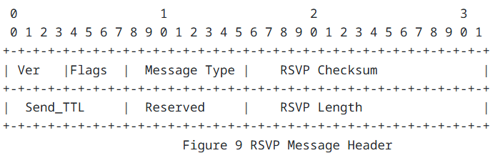
RSVP Instantiation-Messages Extensions
RSVP protocols can be instantiated to implement the host-network collaboration signaling.
RSVP extensions for messages achieve the provisioning of the job-based request, update, notify and acknowledgement, resource quota reservation and release.
JobRequest Message
JobResponse Message
JobUpdate Message
JobNotify Message
JobCancle Message
5

Slide 9
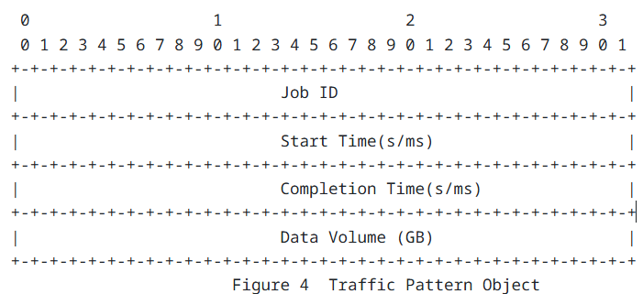
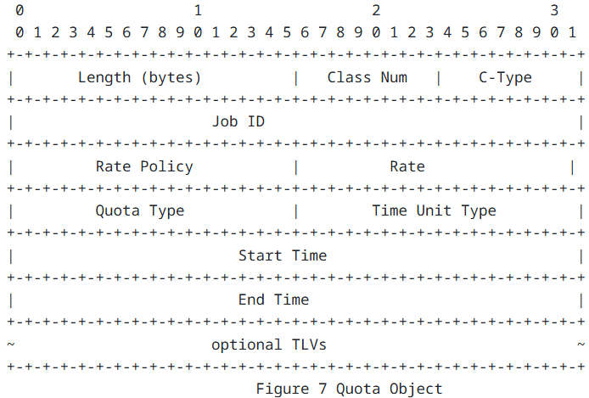
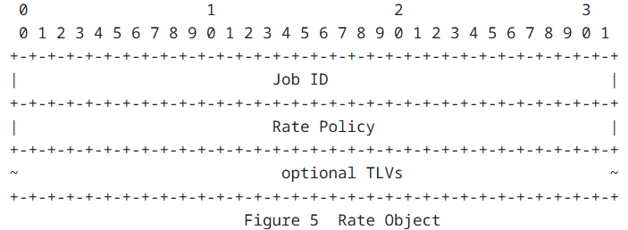
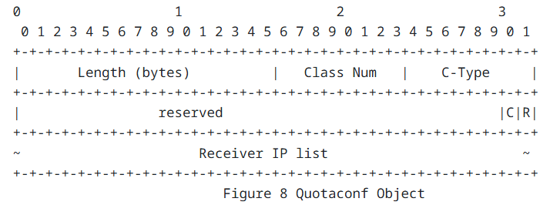
RSVP Instantiation-Objects Extensions
Traffic Pattern Object : carry the traffic pattern and job-based requirements
Rate Object: carry the negotiated rate which is acknowledged
Quota Object: carry the resources quota information
Quotaconf Object: carry the configuration and notification of quota information
5

Slide 10
Thanks !
Comments and suggestions are welcome.

